Slide 1

Airline Reservation & Flight Analytics
Developed By:
Sakshi Patil

Slide 2

INTRODUCTION
This project focuses on analyzing airline reservation data to understand flight operations, ticket pricing, passenger booking trends, and revenue insights. The system uses a relational database and SQL queries to perform analytics across multiple datasets like Airlines, Flights, Passengers, and Reservations.

Slide 3
OBJECTIVE
To store and manage airline data in a structured format
To analyze flight routes, pricing, and airline performance
To evaluate passenger booking trends and seat class choices
To calculate revenue generated through confirmed bookings
To use SQL queries for data retrieval, analysis, and decision-making

Slide 4
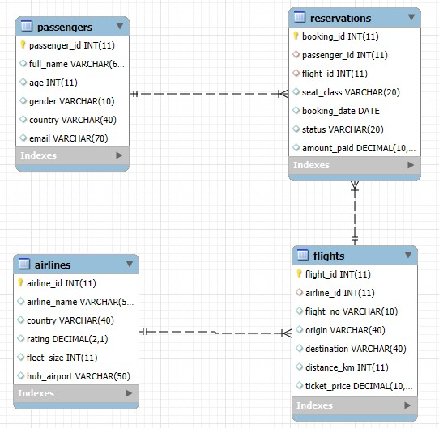
ER-DIAGRAM

Slide 5

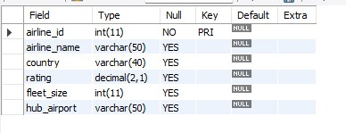
STRUCTURE OF TABLE
This table defines operational identity of each airline and helps analyze service rating, fleet capacity, and main operating hubs for route planning.

Slide 6


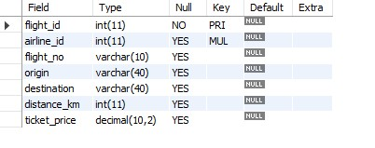
STRUCTURE OF TABLE
This table stores route, pricing, and airline mapping, enabling analysis of travel distance, fare comparison, and the performance of airline networks on specific routes.

Slide 7

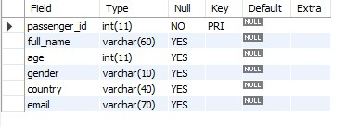
STRUCTURE OF TABLE
This table captures passenger profiles and demographics, helping identify customer segments, nationality trends, and travel behavior patterns for better service planning.

Slide 8

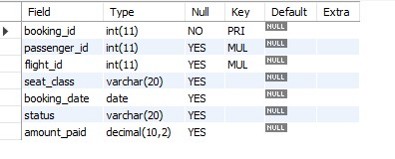
STRUCTURE OF TABLE
This table connects passengers to flight bookings and revenue, allowing performance tracking of ticket class preference, booking status, and earning analysis per flight.

Slide 9

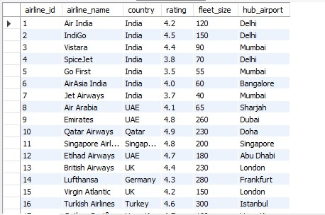

CONTENTS OF TABLE

Slide 10

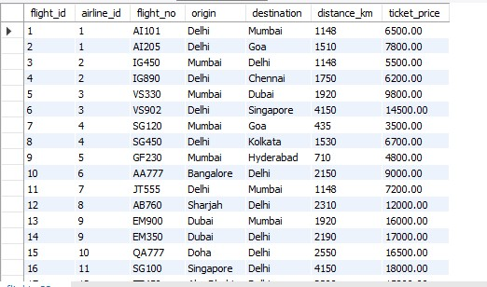
CONTENTS OF TABLE

Slide 11
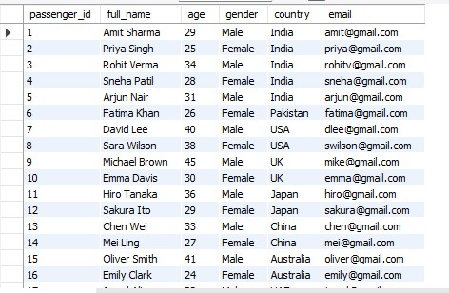
CONTENTS OF TABLE

Slide 12

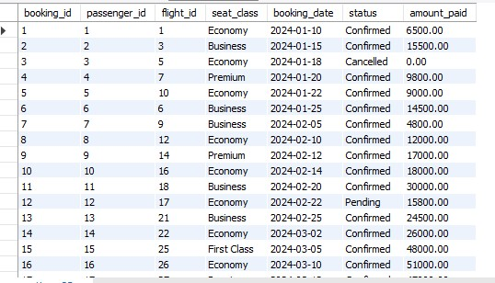
CONTENTS OF TABLE

Slide 13

Basic Queries
Basic queries helped retrieve fundamental information such as airlines, routes, passengers, and booking status, forming the foundation for deeper analysis.

Slide 14

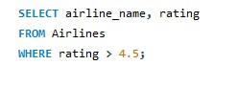
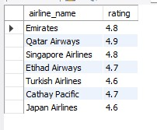

1. List all airlines with rating above 4.5

Slide 15

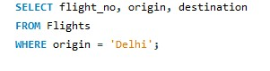
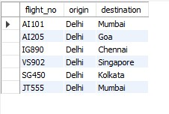
2. Show all flights departing from Delhi

Slide 16


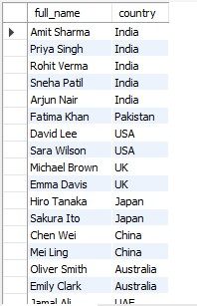

3. Display passenger names and countries

Slide 17
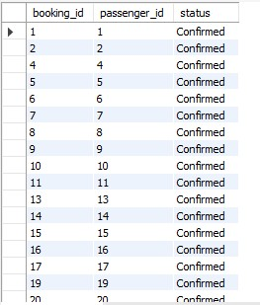
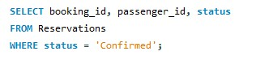
4. Show all confirmed reservation records

Slide 18

Filtering & Sorting
Filtering and sorting queries allowed us to focus on relevant records like age range, high-priced tickets, and top fare bookings, helping identify priority segments and trends.

Slide 19

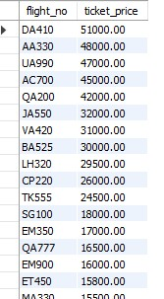
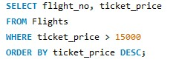
5. Show flights with ticket price > 15000 sorted high → low

Slide 20
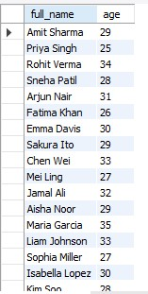
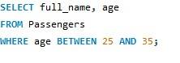
6. List passengers between age 25 and 35

Slide 21
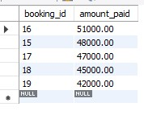
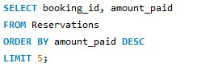
7. Show top 5 highest fare bookings

Slide 22
JOINS
Join queries combined data across tables to provide a real-time connected view of passengers, flights, and airlines, enabling complete booking journey analysis in one output.

Slide 23
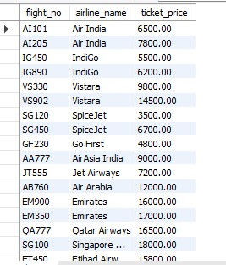
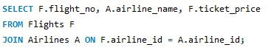
8. Show flight, airline name, and ticket price

Slide 24

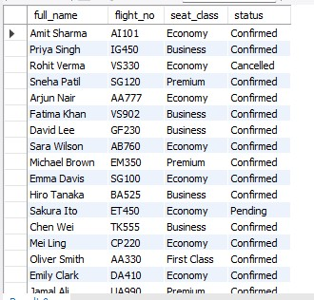
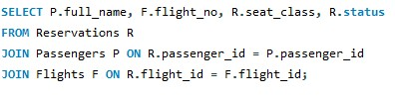
9. Show passenger name with their booked flight

Slide 25
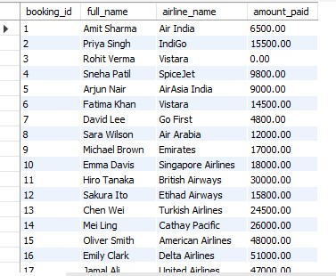
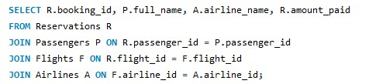
10. List bookings with airline name

Slide 26
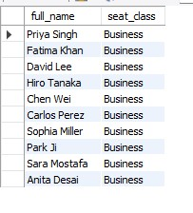
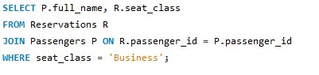
11. Fetch passengers who booked Business Class

Slide 27
Aggregation
Aggregation queries summarized data to calculate revenue, booking count, and airline flight volume, supporting decision-making for business performance measurement.

Slide 28
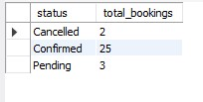
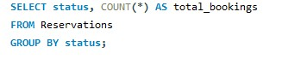
12. Count total bookings by booking status

Slide 29
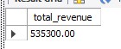
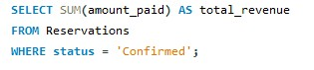
13. Total revenue collected from confirmed bookings

Slide 30
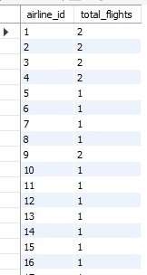
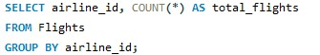
14. Count flights available per airline

Slide 31
Window Functions
Window functions ranked airlines and ticket prices without losing detail, highlighting performance leaders and premium fare routes for strategy and pricing improvement.

Slide 32
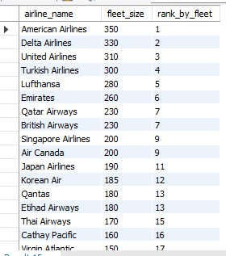
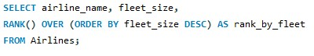
15. Rank airlines by fleet size (largest to smallest)

Slide 33
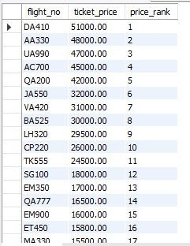
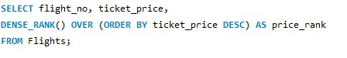
16. Show top 5 highest priced tickets with rank

Slide 34
Subqueries
Subqueries helped filter values dynamically by comparing results with averages, identifying above-average performance, premium passengers, and profitable flight selections.

Slide 35
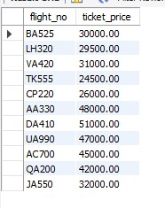
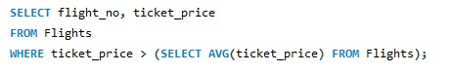
17. Flights having ticket price above average

Slide 36

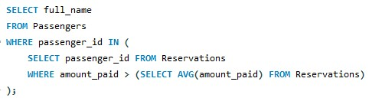

18. Passengers who paid more than average booking amount

Slide 37
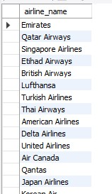
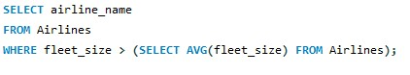
19. Airlines that have more than 200 fleet size

Slide 38
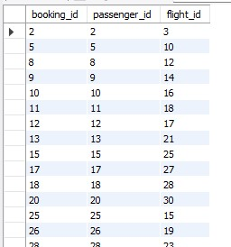
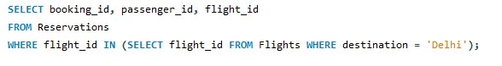
20. Reservations for flights going to Delhi

Slide 39
Conclusion
The Airline Reservation & Flight Analytics system provides clear insights into flight operations, revenue performance, passenger behavior, and airline efficiency. Using SQL queries across joins, aggregations, window functions, and subqueries, we identified patterns like:
Which airlines perform best (fleet/revenue ranking)
Revenue contribution by confirmed bookings
High-value passengers & flight routes
Price variations and flight demand trends
This analysis helps improve operational decision-making, pricing strategies, and passenger experience.

Slide 40

THANK YOU

